Slide 1
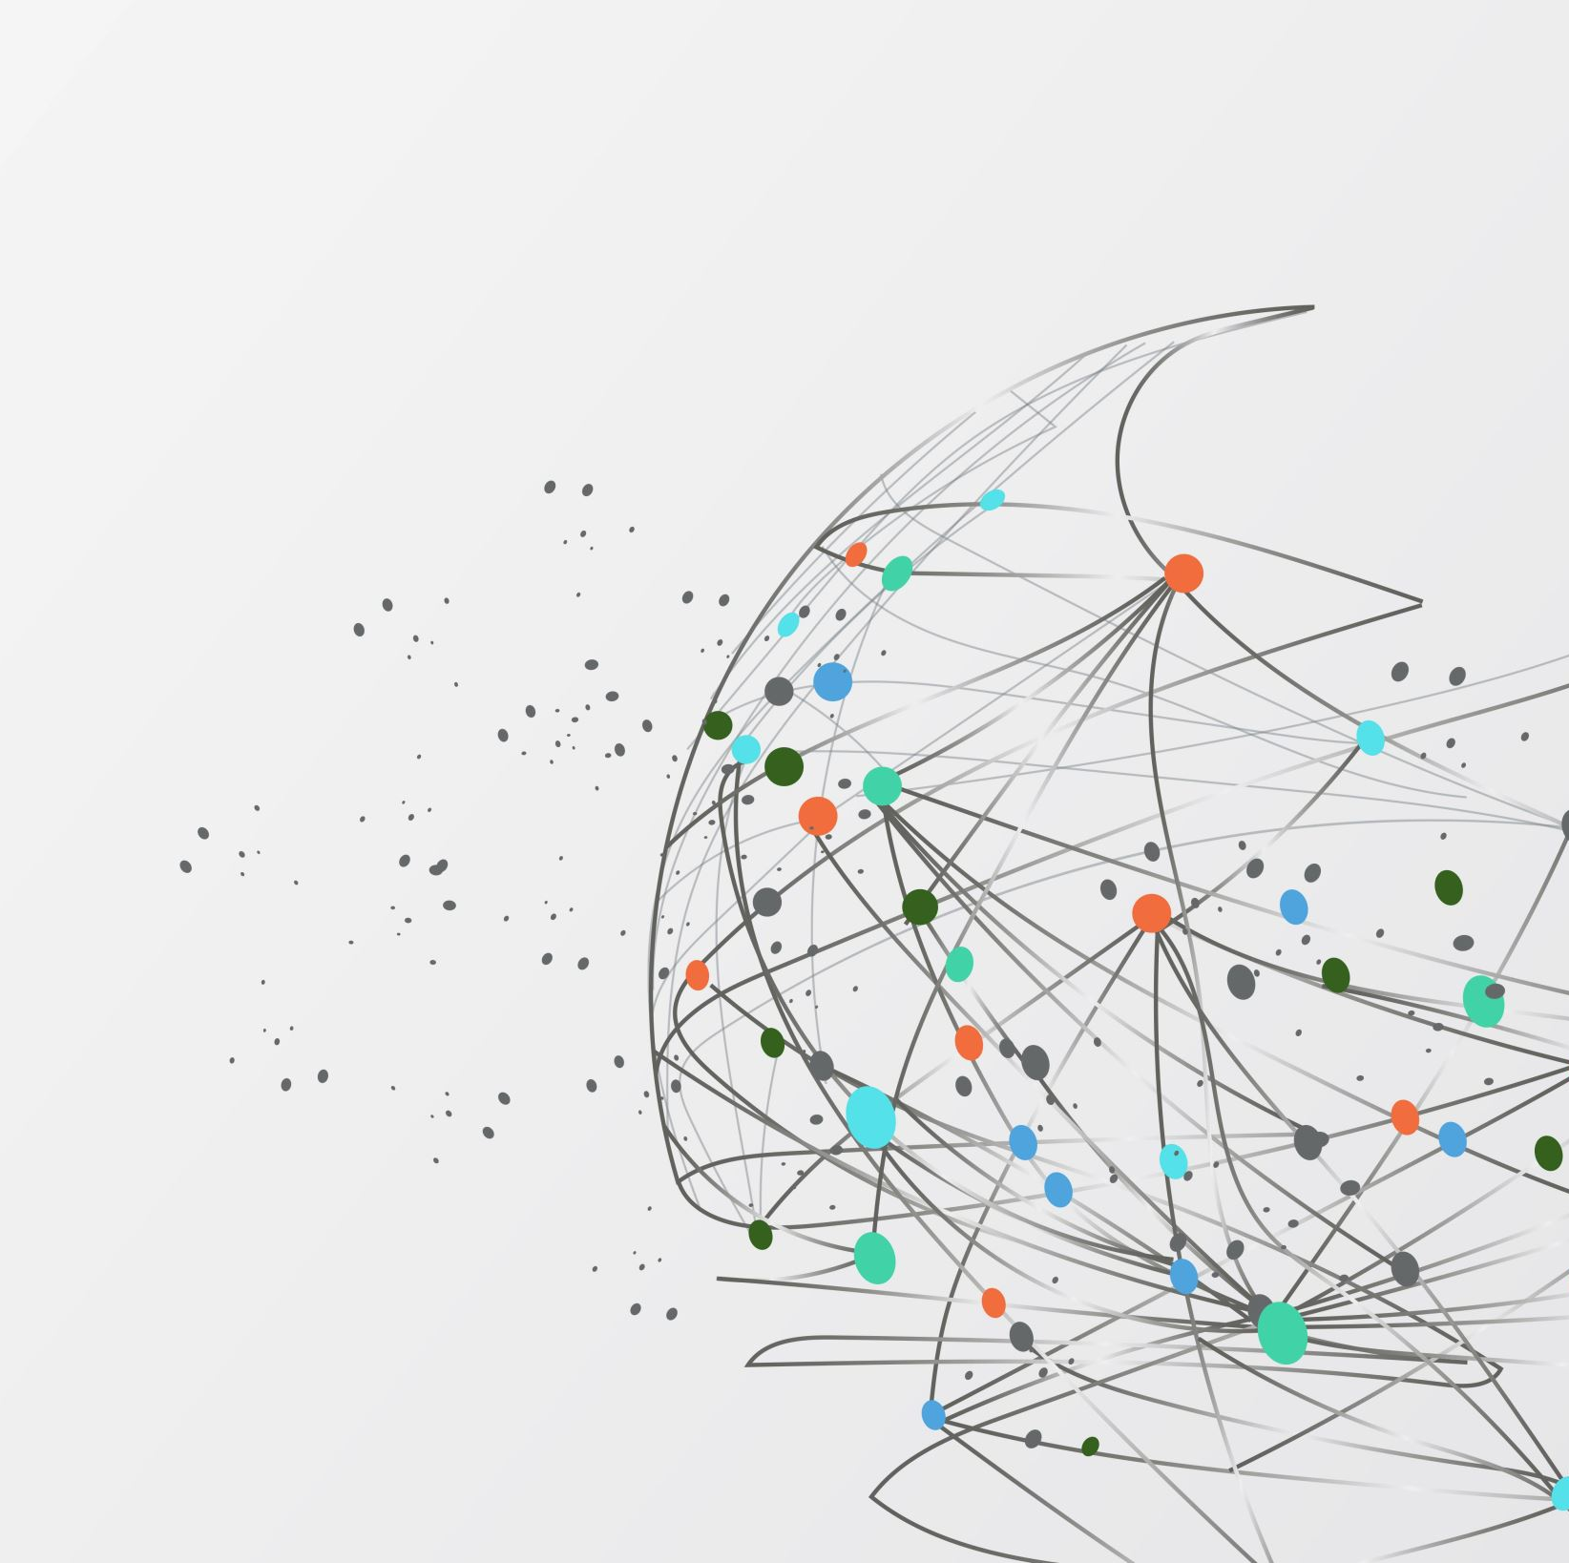
What’s My Personality and What’s Bipolar Disorder?
Stephanie Freitag PhD
Adjunct Assistant Professor
Emory University School of Medicine

Slide 2
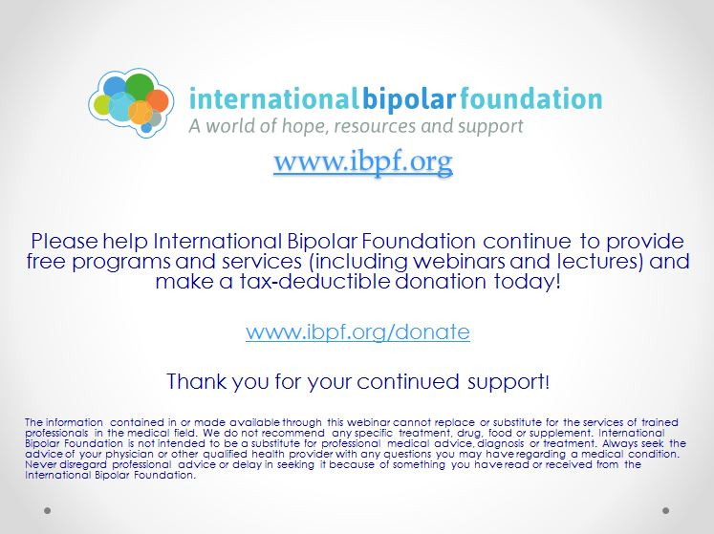

Slide 3
Outline
My background
Bipolar disorder basics
What is personality?
Bipolar Disorder & Personality
Clinical Examples
Clinical Directions
Summary
Questions

Slide 4
My Background
I am a licensed clinical psychologist specializing in serious mental illness and severe psychopathology. I also assist families who have relatives struggling with serious mental illness as I have lived experience in this area.
I am based in Brooklyn, but treat patients in 7 different states (CA, CT, FL, GA, MA, NJ, NY)
I am adjunct assistant faculty at the Emory School of Medicine in Atlanta.
Outside of my clinical work, I am passionate about advocacy related to confronting the stigma associated with serious mental illness.

Slide 5

What is my Personality and What is Bipolar Disorder?
Origin of this question has come from extensive experience with individuals with BD
Often asked in groups and individual therapy
Patients want to understand the root of the disorder
Is it nature or nature?
Focus on psychology research, not psychiatry as I am not a MD

Slide 6
Bipolar Disorder Basics
2.8% of adults have bipolar disorder (US)
Affects 37 million worldwide → .5% of global population
Similar prevalence for males (2.8%) and females (2.9%)
More prevalent among females than males during adolescence
Most prevalent among 18-29-year-olds
https://www.who.int/news-room/fact-sheets/detail/bipolar-disorder
https://www.nimh.nih.gov/health/statistics/bipolar-disorder
Zhong et al., 2024

Slide 7
Bipolar Disorder Basics
Many misdiagnosed
Limited access to services in countries with less wealth
Significant cause of disability worldwide
Often occurs with other mental health concerns (anxiety, substance use etc.)
Increased risk for other health concerns (e.g. cardiovascular disease)
https://www.who.int/news-room/fact-sheets/detail/bipolar-disorder
Lee et al., 2025
Zhong et al., 2024

Slide 8
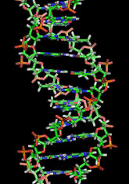
Nature and Nurture
Trauma is a significant predictor of BD
Childhood trauma present in 50% of individuals with BD
Prevalence of PTSD ranges from 16-39%
Fetal development is an area of study for risk in its development
That being said, a recent study suggested it is 70% genetic
Aldinger & Schulze, 2017; McIntyre et al., 2020
Robinson & Bergen, 2021

Slide 9
What is Personality?
“The enduring configuration of characteristics and behavior that comprises an individual’s unique adjustment to life, including major traits, interests, drives, values, self-concept, abilities, and emotional patterns.”
– American Psychological Association

Slide 10
What is Personality?
Complex interplay of nature and nurture
Temperament (biological predisposition) seen in infancy
Enduring / relatively stable, though is impacted by life experiences
Numerous theories of personality from underlying traits (e.g. ”the Big 5”) to unconscious drives (based on Freudian theory)
https://psych.la.psu.edu/about-us/research/personality

Slide 11
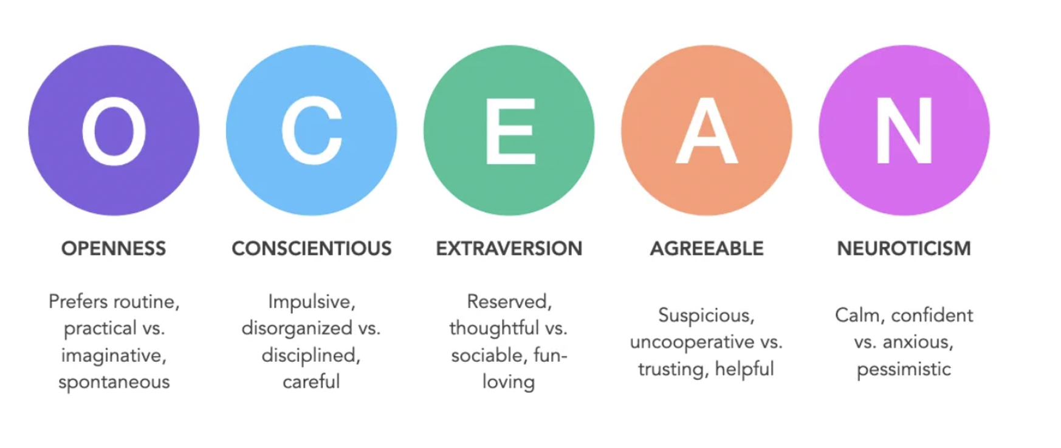
The Big 5
Costa & McCrae, 1993

Slide 12
Models of Personality & Mental Ilness
Vulnerability → personality is the cause of mental disorders
Complication / scar → certain mental disorders change personality
Pathoplasty / exacerbation → personality may exacerbate mental disorder but may also be somewhat separate in its effect
Continuity / spectrum → both are on the same continuum / have the same cause
Etkin et al., 2021; Kang et al., 2023 Watson & Naragon-Gainey, 2014

Slide 13

Bipolar Disorder & Personality

Slide 14
Bipolar Disorder and Personality
Personality functioning may be predictive of
1. Onset
2. Course
3. Severity
4. Treatment response
Ryan et al., 2021; Sparding et al., 2017

Slide 15
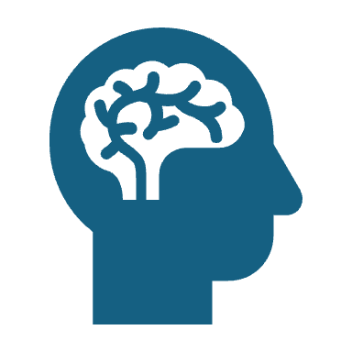
Big Five and Bipolar Disorder
⬆ Openness
⬇️ Conscientiousness
? Agreeableness
⬇️ Extraversion
⬆ Neuroticism
Ryan et al., 2021

Slide 16
Bipolar Disorder or…?
Personality plays role in emotion regulation, impulsivity, and other key parts of BD
May make it hard to differentiate from other disorders
E.g. depression / anxiety disorders have similar profiles
BD and BPD often misdiagnosed → functioning outside of mood episodes may be different
Ryan et al., 2021; Streit et a. 2022

Slide 17
Bipolar Disorder and Personality
Pathology often emphasized
Many positive traits associated with BD
Positive traits underappreciated
Spirituality, empathy, creativity, realism, and resilience
Mania enhances creativity → hard to give up
Depression enhances realism
Recovery from episodes facilitates resilience
Galvez et al., 2011

Slide 18

Clinical Examples

Slide 19

Patient A
22 years old
Started college but did not complete it
Bipolar Disorder I
Rapid cycler
Severe childhood trauma history
Comorbid substance use disorder / borderline personality disorder

Slide 20
Patient B
33 years old
Physician
Bipolar Disorder II
No known trauma history
No diagnosed comorbidities outside of manageable anxiety

Slide 21
Clinical Directions

Slide 22

Clinical Directions
Early identification of temperament / personality traits in childhood
For example, neuroticism → greater sensitivity to triggers
Effective interventions for trauma
Due to similarities across mental disorders, focusing on transdiagnostic treatments
Barlow et al., 2021

Slide 23
Clinical Directions
The talking cure is unlikely to be the most useful
Skills to manage mood, anxiety → IPSRT
Strength-based approach → using positive psychology to cultivate adaptive characteristics
Fostering resilience
Acceptance of negative emotions → not overvaluing happiness (ACT therapy)
Barlow et al., 2021; Ford et al, 2015; Lee et al., 2017

Slide 24

Summary
Personality itself is a complex topic
Bipolar disorder development, severity, and course influenced by personality
Insight into personality characteristics across diagnoses is important
Crucial to emphasize strengths without a singular focus on pathology

Slide 25
References
Aldinger, F., & Schulze, T. G. (2017). Environmental factors, life events, and trauma in the course of bipolar disorder. Psychiatry and clinical neurosciences, 71(1), 6–17. https://doi.org/10.1111/pcn.12433
Barlow, D. H., Curreri, A. J., & Woodard, L. S. (2021). Neuroticism and disorders of emotion: A new synthesis. Current Directions in Psychological Science, 30(5), 410-417
Costa, P. T., & McCrae, R. R. (1992). The five-factor model of personality and its relevance to personality disorders. Journal of Personality Disorders, 6(4), 343–359. https://doi.org/10.1521/pedi.1992.6.4.343
Ford, B. Q., Mauss, I. B., & Gruber, J. (2015). Valuing happiness is associated with bipolar disorder. Emotion (Washington, D.C.), 15(2), 211–222. https://doi.org/10.1037/emo0000048\
Etkin, P., Ibáñez, M. I., Ortet, G., & Mezquita, L. (2022). Longitudinal associations between the Five-Factor Model of personality and the bi-factor model of psychopathology: Continuity, pathoplasty and complication effects in adolescents. Journal of Psychopathology and Behavioral Assessment, 44(2), 405–417. https://doi.org/10.1007/s10862-021-09903-1
Galvez, J. F., Thommi, S., & Ghaemi, S. N. (2011). Positive aspects of mental illness: a review in bipolar disorder. Journal of affective disorders, 128(3), 185–190. https://doi.org/10.1016/j.jad.2010.03.017
Kang, W., Steffens, F., Pineda, S. et al. Personality traits and dimensions of mental health. Sci Rep 13, 7091 (2023). https://doi.org/10.1038/s41598-023-33996-1
Lee, D., Cha, B., Park, C. S., Kim, B. J., Lee, C. S., Lee, S. J., Seo, J. Y., Cho, Y. A., Ha, J. H., & Choi, J. W. (2017). Effects of resilience on quality of life in patients with bipolar disorder. Journal of affective disorders, 207, 434–441. https://doi.org/10.1016/j.jad.2016.08.075
Lee, YB., Kim, H., Lee, J. et al. Bipolar disorder and the risk of cardiometabolic diseases, heart failure, and all-cause mortality: a population-based matched cohort study in South Korea. Sci Rep 14, 1932 (2024). https://doi.org/10.1038/s41598-024-51757-6
McIntyre, R. S., Laliberté, F., Germain, G., MacKnight, S. D., Gillard, P., & Harrington, A. (2022). The real-world health resource use and costs of misdiagnosing bipolar I disorder. Journal of affective disorders, 316, 26–33. https://doi.org/10.1016/j.jad.2022.07.069
Personality. Department of Psychology. (2023, May 25). https://psych.la.psu.edu/about-us/research/personality
Robinson, N., & Bergen, S. E. (2021). Environmental Risk Factors for Schizophrenia and Bipolar Disorder and Their Relationship to Genetic Risk: Current Knowledge and Future Directions. Frontiers in genetics, 12, 686666. https://doi.org/10.3389/fgene.2021.686666
Ryan, K. A., Han, P., Zhang, Y., Marshall, D. F., Yocum, A. K., McInnis, M. G., & Zöllner, S. (2021). Stability of personality traits in bipolar disorder: Findings from a longitudinal cohort. Journal of affective disorders, 283, 1–10. https://doi.org/10.1016/j.jad.2021.01.030
Singh, B., Swartz, H. A., Cuellar-Barboza, A. B., Schaffer, A., Kato, T., Dols, A., ... & Frye, M. A. (2025). Bipolar disorder. The Lancet, 406(10506), 963-978
Sparding, T., Pålsson, E., Joas, E., Hansen, S., & Landén, M. (2017). Personality traits in bipolar disorder and influence on outcome. BMC psychiatry, 17(1), 159. https://doi.org/10.1186/s12888-017-1332-0
Swartz, H. A., Levenson, J. C., & Frank, E. (2012). Psychotherapy for bipolar II disorder: The role of interpersonal and social rhythm therapy. Professional Psychology: Research and Practice, 43(2), 145–153. https://doi.org/10.1037/a0027671
Streit, F., Witt, S.H., Awasthi, S. et al. Borderline personality disorder and the big five: molecular genetic analyses indicate shared genetic architecture with neuroticism and openness. Transl Psychiatry 12, 153 (2022). https://doi.org/10.1038/s41398-022-01912-2
U.S. Department of Health and Human Services. (n.d.). Bipolar disorder. National Institute of Mental Health. https://www.nimh.nih.gov/health/statistics/bipolar-disorder
Watson, D., & Naragon-Gainey, K. (2014). Personality, Emotions, and the Emotional Disorders. Clinical psychological science : a journal of the Association for Psychological Science, 2(4), 422–442. https://doi.org/10.1177/2167702614536162
World Health Organization. (n.d.). Bipolar disorder. World Health Organization. https://www.who.int/news-room/fact-sheets/detail/bipolar-disorder
Zhong, Y., Chen, Y., Su, X., Wang, M., Li, Q., Shao, Z., & Sun, L. (2024). Global, regional and national burdens of bipolar disorders in adolescents and young adults: a trend analysis from 1990 to 2019. General psychiatry, 37(1), e101255. https://doi.org/10.1136/gpsych-2023-101255

Slide 26

Questions? Reactions?
drstephanielfreitag@gmail.com

